Slide 1


Slide 2
Lecture 05
Information Technology
Computer
I/O Processing
Data Storage
Networking and internet standards
Application and Business software
Social Media Websites/ Information systems
Fundamentals of Artificial Intelligence

Slide 3
Telecommunication
Basic of wireless Telecommunication
Mobiles
Satellites
Surveillance and GPS
SONAR, RADAR
Fiber Optics
Remote sensing
Use of GPS in environment
Test of first four lectures/Assignment

Slide 4
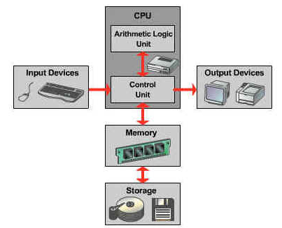
I/O Processing

Slide 5
Input Devices
The data or instruction given to the computer is called input. Any hardware component that allows a user to enter data and instructions into a computer are called input devices.
Most commonly used devices are Given here
Keyboard
keyboard is used to enter text. It contain alphabetic, numeric and other keys for entering different type of data
2. Mouse
Mouse is a pointing. It controls the pointer on the screen. The users gives instructions to the computer through mouse. It have different buttons.

Slide 6
3. Microphone
Microphone is used to enter voice into the computer.
Scanner
it reads printed text and graphics then translate the result into digital form.
5. Digital Camera
Digital camera is used to take photos. It does not use traditional camera films
6. PC camera
PC camera is used to create movies and take photos on the PC, and also use to make video calls.

Slide 7
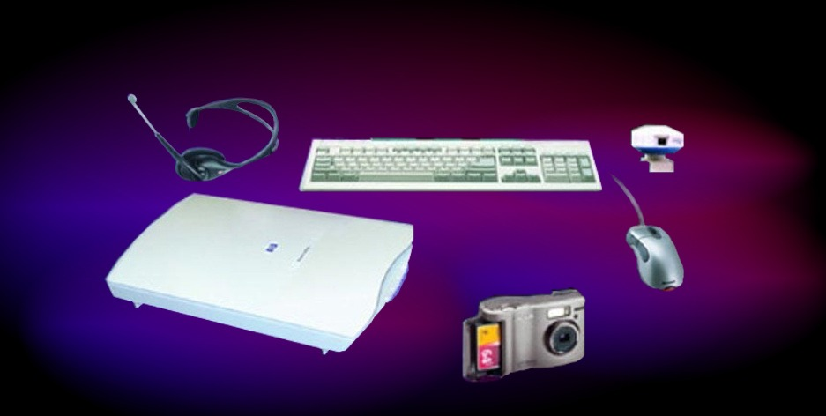
Any hardware component that allows a user to enter data and instructions into a computer
microphone

Slide 8
Output Devices
The data processed into useful information is called output. A hardware component used to display information to the users is called output devices. Most commonly output devices are……
Monitor: Monitor is used to display text, graphics and video outputs.
Printer: printer is used to display printed output on paper or transparency
Speaker: Speaker is used to hear sound, music and voice output.

Slide 9
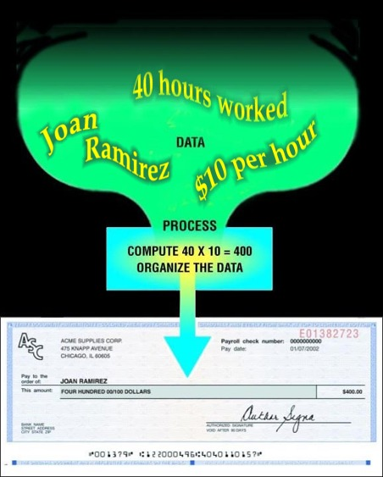
Difference B/w DATA and INFORMATION
Data
Collection of raw unprocessed facts, figures, and symbols
Information
Data that is organized, meaningful, and useful

Slide 10
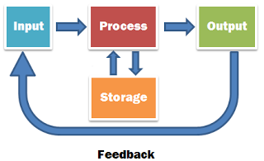
I/O processing
Processing basically is a process in which raw data is converted into a useful information. It is done with help of several components ……
Fundamental Parts in Processing of Data
RAM
ROM
Central Processing Unit
Data Buses
Central Processing Unit
ALU
Arithmetic Unit
Logic Unit
2. Control Unit
System Clock
Buses
Data Bus
Addresses Bus
Control Bus

Slide 11
Central Processing Unit
CPU ….Central Processing Unit
Most important component of a computers. It is called the brain of a computer.
Located on the motherboard.
It executes instructions and tells other parts of the computers. Most of the work consist of calculations and data transfer. All functions usually done on a single chip
A single chip that consist of two or more separate processors is known as multi-core processor

Slide 12
Dual-core processor: A dual-core processor is a chip that contains two separate processors.
Quad-core Processor: A quad processor is a chip that contain four separate processors.
CPU consists of two main units:
ALU
CU
1. ALU (Arithmetic and logic Unit)
ALU is a part of CPU. Actual executions of instructions take place in this part. All arithmetic and logical operations are preformed in ALU. It consist of two units
a) Arithmetic unit and
b) Logic Unit

Slide 13
a) . Arithmetic Unit
Arithmetic operations include addition, subtraction, multiplication, and division
+ add , —subtract, X multiply, / divide etc.
b) . logic unit
it perform logical operations like comparing two data item to find which data item is greater, less or equal to other
=, <> equal to, not equal to
>, !> greater than, not greater than
<, !< less than, not less than
>=, !>= greater than or equal to, not greater than or equal to

Slide 14
2. Control Unit
Control unit is an important component of CPU. It acts like a supervisors of the computer. It does not executes instruction by itself. It controls and coordinates all activates of computer system.
Important task performs by CU
It fetches instructions from the main memory
It interprets the instructions to find what operation is to be preformed
It control the execution of instruction

Slide 15
RAM (Random Access Memory)
It is also called direct access memory. Random access means that each individual byte in memory can be accessed directly
RAM is used to store data and instruction temporarily. A program must be loaded into RAM before execution.
RAM is volatile memory it means that it content are lost when the power is turned off. RAM is read/write memory. RAM is also called Data main memory or primary storage.

Slide 16
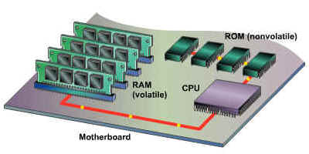
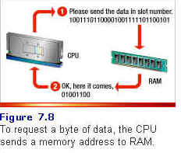
Interaction between RAM and CPU

Slide 17
RAM and CPU are both placed on the motherboard
RAM is a temporary memory that stores data and stores instruction from RAM when required.
The interaction between CPU and RAM take place every time an instruction is executed.
RAM is connected to CPU through data bus, control bus and data bus. It is collectively known as system bus.
This system bus consist of electrical paths to transfer information between CPU and RAM.

Slide 18
Memory: Cache Memory
Moving data between RAM and the CPU's registers is one of the most time-consuming operations a CPU must perform, simply because RAM is much slower than the CPU. A partial solution to this problem is to include cache memory. Cache (pronounced cash) memory is extremely fast memory, which hold the most recently used data and instructions.
When a program is running and the CPU needs to read data or program instructions from RAM, the CPU checks first to see whether the data is in cache memory. If the data is not there, the CPU reads the data from RAM into its registers, but it also loads a copy of the data into cache memory. The next time the CPU needs that same data, it finds it in the cache memory and saves the time needed to load the data from RAM.

Slide 19
The following steps are preformed when CPU wants to read DATA from RAM.
CPU placed the read request on control bus
CPU places the addresses of required Byte or word on address bus
Memory unit reads the commands and addresses. It puts the required data on the bus.
CPU read the required DATA from data bus.
The following steps are preformed when CPU wants to write DATA on RAM
CPU places the write request on control bus.
CPU places the address of the word where to write Data on the Address Bus.
Memory units get ready to do the operation.
CPU puts DATA on the DATA bus.
Memory units reads the data and places it in the required bus.

Slide 20
NON Volatile Memory: ROM
ROM memory is one example of nonvolatile memory. ROM is Read only memory, and it contains the boot-up instructions for the comptuer. The information contained in ROM memory is maintained even after the power is shut off. Nonvolatile chips always hold the same data; the data in them cannot be changed except through a special process that overwrites the data. In fact, putting data permanently into this kind of memory is called "burning in the data," and it is usually done at the factory. During normal use, the data in these chips is only read and used--not changed--so the memory is called read-only memory (ROM). There are newer versions of ROM, which can be overwritten or re-programmed, but it requires special software to do.
One important reason a computer needs ROM is that it must know what to do when the power is first turned on. Among other things, ROM contains a set of start-up instructions, which ensures that the rest of memory is functioning properly, checks for hardware devices, and checks for an operating system on the computer's disk drives.

Slide 21
Computer Buses
A bus consists of a set of parallel lines. It is used to transfer data between different component of the computer. One line bus can transfer one bit at a time.
The capacity of computer bus depends on the number of DATA lines in it. A bus with 16 line can carry 16 bits or bytes.
CPU communicate with other components of computer through buses.

Slide 22
System Buses
System buses is used to connect the main component of a computer such as main memory. System buses are part of motherboard, Computer normally have 70-100 lines.
Types of buses
Data Bus
Data bus is the most common type of bus. It is used to transfer data between different component of computer
The number of line in the Data bus effect the speed of Data transfer
2. Address Buses
Each component is assigned a unique ID, this ID is called the address of that component. If a component wants to communicate with another component this need a special address. This bus is unidirectional bus, it can carry data only in one direction.
3. Control Bus
The CPU transmits a variety of control signals to components and devices to transmit control signals to the CPU using the control bus. The control bus is bidirectional and assists the CPU in synchronizing control signals to internal devices and external components. It is comprised of interrupt lines, byte enable lines, read/write signals and status lines.

Slide 23
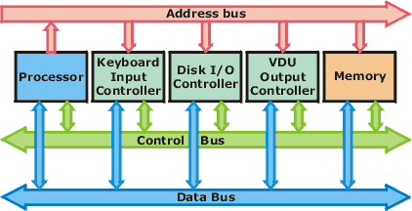
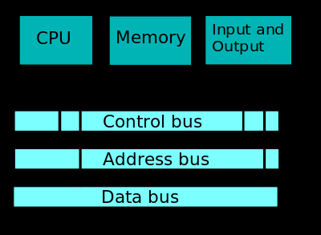

Slide 24
Storage Devices
Actually there are two types of storage
Primary Storage
Secondary Storage
Primary Memory :
Primary memory also known as memory, is the only one directly accessible to the CPU. The CPU continuously reads instructions stored there and executes them. Any data actively operated on is also stored there in uniform manner. It is a form of semiconductor storage known as random access memory (RAM) and sometimes other forms of fast but temporary storage. It is small-sized, light, but quite expensive. This type of memory is divided into the following two types :
RAM
ROM

Slide 25
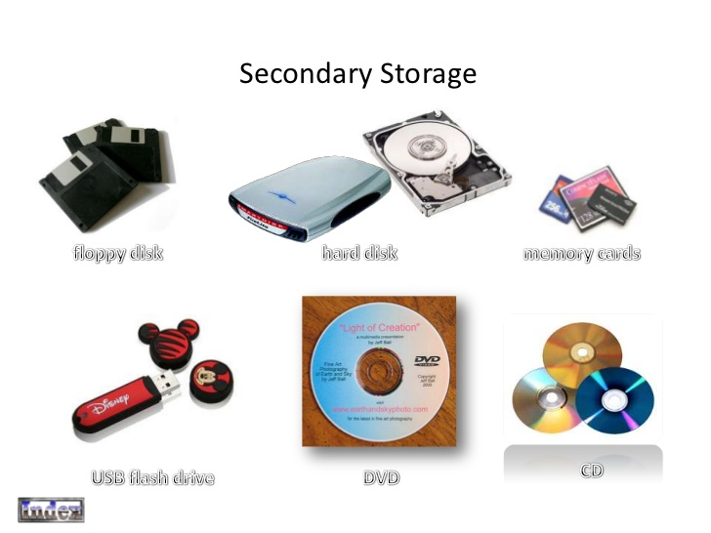
Secondary Storage Devices

Slide 26
Secondary Memory
It stores programmes or information permanently.
It is not directly accessible by the CPU.
The computer usually uses its input/output channels to access secondary storage and transfers desired data using intermediate area in primary storage.
Less expensive than primary storage.
Modern computer systems typically have an order of magnitude more secondary storage than primary storage and the data is kept for a longer time there.
The following figure shows the commonly used secondary storage devices and their classification.

Slide 27
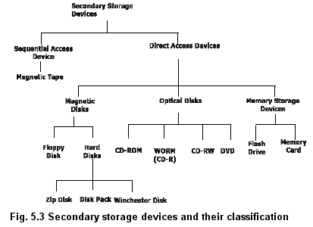

Slide 28
In modern computers, hard disks are usually used as secondary storage. The time taken to access a given byte of information stored on a hard disk is typically a few thousandths of a second
. By contrast, the time taken to access a given byte of information stored in random access memory is measured in thousand-millionths of a second.
Some other examples of secondary storage technologies are: Flash Memory ( e.g. USB sticks or keys), Floppy Disks, Magnetic tape, Paper tape, Punch Cards, standalone RAM disks, and Zip drives.

Slide 29
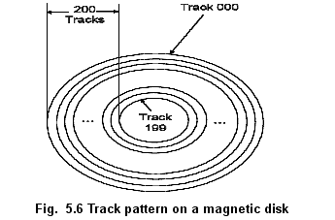
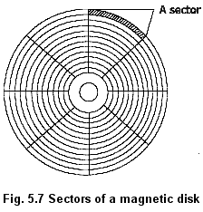
The surface of a platter is organized as a number of concentric tracks. Each track is divided into sectors. The following diagram shows the tracks and sectors of a platter.
Magnetic Disc

Slide 30
What is Magnetic storage?
Magnetic storage is the manipulation of magnetic fields on a medium in order to record audio, video or other data.
Magnetic storage has been around in many forms since 1888 by Oberlan Smith, who publicized his audio recording on a wire in Electrical World. In broad terms, magnetic storage mostly works very similarly to Smith's recording. Read and write heads (either combined or separate) are used to align the magnetic fields on the recording medium. A great variety of analog and digital devices using magnetic storage.

Slide 31
Hard drive
A hard disk drive (sometimes abbreviated as Hard drive, HD, or HDD) is a non-volatile memory hardware device that permanently stores and retrieves information. There are many variations, but their sizes are generally 3.5" and 2.5" for desktop and laptop computers respectively. A hard drive consists of one or more platters to which data is written using a magnetic head, all inside of an air-sealed casing. Internal hard disks reside in a drive bay, connect to the motherboard using an ATA, SCSI, or SATA cable, and are powered by a connection to the PSU (power supply unit).

Slide 32
A hard drive can be used to store just about any type of data, including pictures, music, videos, and text documents. Computers have a hard drive and use it to store files for the operating system and software that run on the computer, as well as files created or downloaded to the computer by a user.
In computer disk storage, a sector is a subdivision of a track on a magnetic disk or optical disc. Each sector stores a fixed amount of user-accessible data, traditionally 512 bytes for hard disk drives (HDDs) and 2048 bytes for CD-ROMs and DVD-ROMs
Magnetic storage means storage of Data on matnetiaed materials.

Slide 33
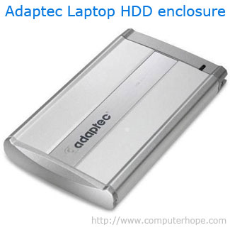
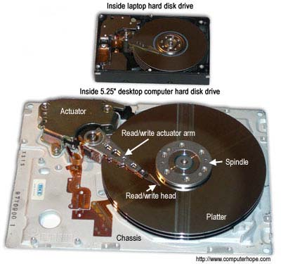
Hard drive components external and internal

Slide 34
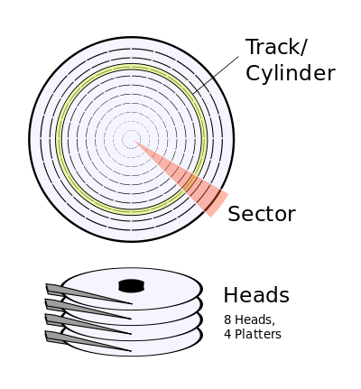
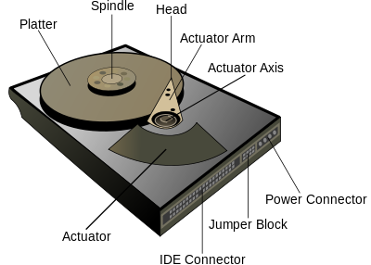
Components of Hard Disc

Slide 35
Working of Hard disc
The platters spin around the spindle
data is requested to be read from a particular area of a platter
the actuator arm moves the read head to that track
Once the data sector that is required has spun around and under the read head, data is read
Read data is sent from the IDE connector to main memory

Slide 36
Writing data is very similar:
The platters spin around the spindle
data is sent to the hard disk using the IDE connector
the actuator arm moves the write head to the track that will be written to
Once the data sector that is required has spun around and under the write head, data is written to the platter

Slide 37
Pros & Cons
Pros
Fast seek times
Random access
High capacities possible
Low cost per megabyte
Cons
Very susceptible to damage from physical shocks

Slide 38
How is data read and stored on a hard drive?
Data sent to and read from the hard drive is interpreted by the disk controller, which tells the hard drive what to do and how to move the components within the drive. When the operating system needs to read or write information, it examines the hard drive's File Allocation Table (FAT) to determine file location and available write areas. Once they have been determined, the disk controller instructs the actuator to move the read/write arm and align the read/write head. Because files are often scattered throughout the platter, the head needs to move to different locations to access all information.

Slide 39
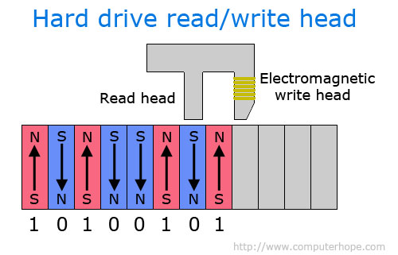

Slide 40
All information stored on a traditional hard drive, like the above example, is done magnetically. After completing the above steps, if the computer needs to read information from the hard drive, it would read the magnetic polarities on the platter. One side of the magnetic polarity is 0, and the other is 1. Reading this as binary data, the computer can understand what the data is on the platter. For the computer to write information to the platter, the read/write head aligns the magnetic polarities, writing 0's and 1's that can be read later.

Slide 41
External and Internal hard drives
Although most hard drives are internal, there are also stand-alone devices called external hard drives, which can backup data on computers and expand the available disk space. External drives are often stored in an enclosure that helps protect the drive and allows it to interface with the computer, usually over USB or eSATA. A great example of an external backup device that supports multiple hard drives is the Drobo.
External hard drives come in many shapes and sizes. Some are large, about the size of a book, while others are about the size of a cell phone. External hard drives can be very useful since they usually offer more space than a jump drive and are still portable. The picture to the right is an example of a laptop hard disk drive enclosure from Adaptec. The user may install a laptop hard drive of any storage capacity into the enclosure and connect it via USB port to the computer.

Slide 42
HDD being replaced by SSD
Solid State Drives (SSDs) have started to replace hard disk drives (HDDs) because of the distinct performance advantages they have over HDD, including faster access times and lower latency. While SSDs is becoming more and more popular, HDDs continue to be used in many desktop computers largely due to the value per dollar that HDDs offer over SSDs. However, more and more laptops are beginning to utilize SSD over HDD, helping to improve the reliability and stability of laptops.

Slide 43
Floppies come in two basic sizes:
1.5¼-inch: The common size for PCs made before 1987. This type of floppy is generally capable of storing between 100K and 1.2MB (megabytes) of data. The most common sizes are 360K and 1.2MB.
2.3½-inch: Floppy is something of a misnomer for these disks, as they are encased in a rigid envelope. Despite their small size, microfloppies have a larger storage capacity than their cousins — from 400K to 1.4MB of data. The most common sizes for PCs are 720K (double-density) and 1.44MB (high-density). Macintoshes support disks of 400K, 800K, and 1.2MB.

Slide 44
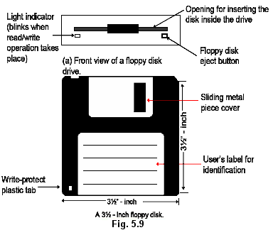

Slide 45
floppies can be protected so that the information that has been stored on the floppy disk cannot be erased. By sliding a plastic tab located on the right punched out hole on the diskette, so that it is open, the diskette cannot be written to. The computer will prompt you with a message if you try to write to the diskette when it is protected in this manner.

Slide 46
Magnetic Tape
Magnetic Tape has been used for data storage for over 70 years. During this time, many advances in tape formulation, packaging, and data density have been made. Modern magnetic tape is most commonly packaged in cartridges and the magnetic tape medium is a plastic ribbon usually 1/2 inch or 1/4 inch wide and 50 to 2400 feet long. It is coated with a recording material that can be magnetized such as iron oxide or chromium dioxide.
It is basically sequential magnetic storage Device.

Slide 47
Punch card
Early method of data storage used with early computers. Punch cards also known as Hollerith cards and IBM cards are paper cards containing several punched holes that were punched by hand or machine to represent data. These cards allowed companies to store and access information by entering the card into the computer. The picture is an example of a woman using a punch card machine to create a punch card.

Slide 48
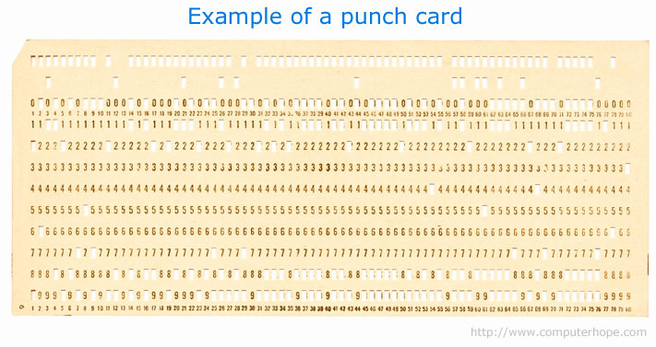
How did punch cards work?
Using a punch card machine like that shown in the picture above, data can be entered into the card by punching holes on each column to represent one character. Below is an example of a punch card

Slide 49
Reading of Data from the Punch Card
Once a card has been completed or the return key has been pressed the card technically "stores" that information. Because each card could only hold so much data if you wrote a program using punch cards (one card for each line of code) you would have a stack of punch cards that needed to remain in order.
To load the program or read a punch card data, each card is inserted into a punch card reader that input the data from the card into a computer. As the card is inserted, the punch card reader starts on the left-top-side of the card and reads vertically starting at the top and moving down. After the card reader has read a column it moves to the next column.
After magnetic media was created and began to be cheaper punch cards stopped being used.

Slide 50
USB (memory stick) Flash Drive
USB Flash drives are solid state, that means that there are no moving parts. This is very useful for seek times as we don't have to wait for mechanical movement, meaning seek time is very low and it allows for fast Random Access Memory. Flash drives can be set to read only mode, but they will always allow for reading and writing. The size of flash drives is not as great as a Hard Disk and they are generally much more expensive per megabyte

Slide 51
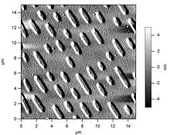


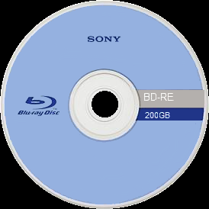

Optical media
Optical media works by creating a disc with a pitted metallic surface. There are several different types of disk out there ranging from 650 MB to 128 GB, with the pits and lands getting closer together for higher volume disks. The principle behind how each of them works is the same.

Slide 52
Networking and Internet Standards
“A network is defined as a system for connecting computers using a single
transmission technology. The computers can communicate with each other in a network.
They can send and receive data from each other when they are in a network “
“The Internet is defined as the set of networks connected by routers that are configured to pass traffic among any computers attached to any network in the set. By
internet many computers which are at longer distances from each other can communicate
with each other. “

Slide 53
Communication through Networking
Computer communications describes a process in which two or more computers or devices transfer data, instructions, and information
Sending device
Communications channel
Receiving device

Slide 54
Classification of Networks
CLASSIFICATION OF NETWORKS
Computer networks are classified by four factors which are as follow:
1) BY SIZE:
2) BY CONNECTIVITY:
3) BY MEDIUM:
4) BY MOBILITY:

Slide 55
1) BY SIZE:
According to their size there are two classifications of networks.
a. Local Area Network. ( LAN)
In LAN network occupies the smaller area like a room a floor or a building.
A local area network (LAN) is a network that connects computers and devices in a limited geographical area
A wireless LAN (WLAN) is a LAN that uses no physical wire.
transmission, bandwidth and latency, management, security, reliability, billing and their standards.

Slide 56
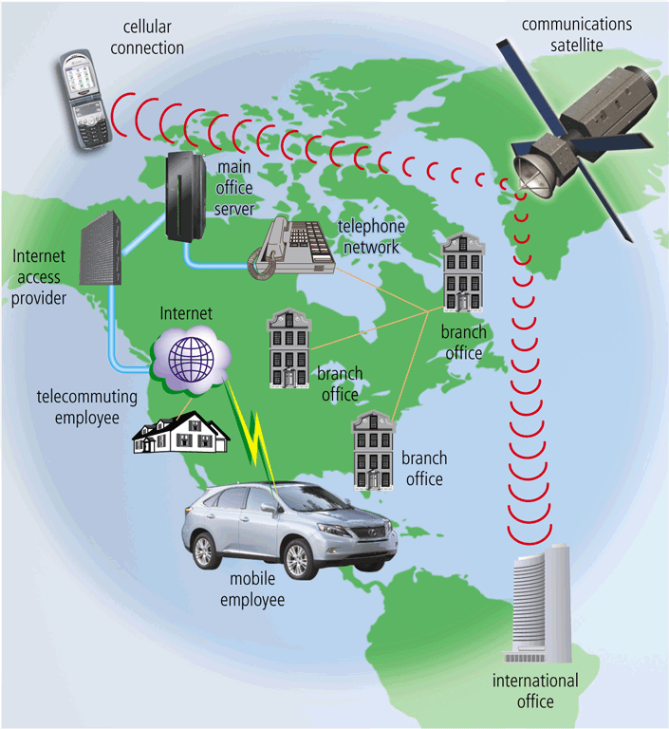
b. Wide Area Network (WAN)
A metropolitan area network (MAN) connects LANs in a metropolitan area
A wide area network (WAN) is a network that covers a large geographical area

Slide 57
2) BY CONNECTIVITY
Networks are also classified by connectivity in which two topologies are discussed.
a) Point-to-Point
b) Broadcast
a) POINT-TO-POINT:
In Point-to-Point topology there are two topologies.
1) STAR topology
2) TREE topology
In star topology each computer is connected to a central hub. The communication takes place through the hub. It is shown in the figure below.

Slide 58
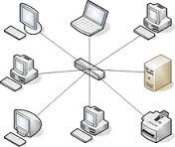
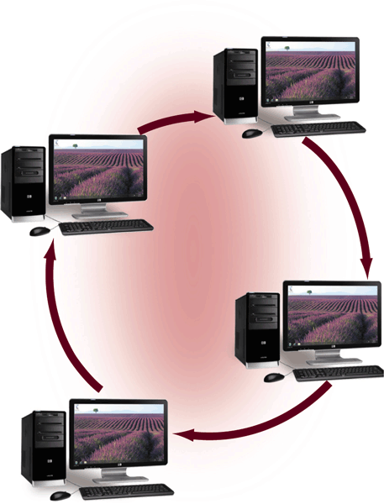
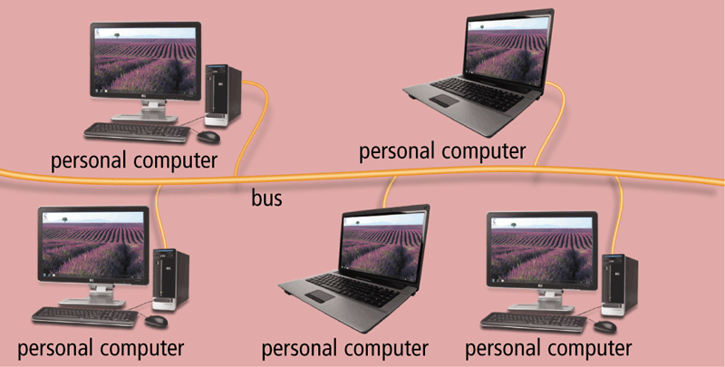
Ring network
Bus network

Slide 59
3. BY Medium Networks
This classify basically depends upon the medium being used to communicate different systems. This medium differs as their range, speed of transmission, Maintenance cost, Topology being used and reliability and such like characteristic. The most commonly used medium are
Copper wire
Optical fiber
Radio wave
CO-axial wires

Slide 60
4. Classification by Mobility
On the basis of classification networks are divided into two types
Fixed Network
Mobile Network
In the modern era mobile network has become a hot issue. However certain issues are attached with the mobile networks
Location and tracking
Semi persistence
Administration is a difficult process

Slide 61
Networking in Daily life
Major use in businesses
Advertising companies
Accounting and auditing firms
Some entire industries are developing networking components
Used in switching application
Industries units and Banks are dependent on networking for their proper functioning.
In Medical field in advanced countries networking are being used.

Slide 62
Application and Businesses Software's
Business software or business application is any software or set of computer programs that are used by business users to perform various business functions. These business applications are used to increase productivity, to measure productivity and to perform business functions accurately.
The term covers a large variation of users within the business environment, and can be categorized by using a small, medium and large matrix:

Slide 63
The small business market generally consists of home accounting software such as office suits or Microsoft office.
The medium size, or small and medium-sized enterprise (SME), has a broader range of software applications, ranging from accounting, groupware, customer relationship management, human resource management systems, outsourcing relationship management, loan origination software, shopping cart software, field service software, and other productivity enhancing applications.

Slide 64
The last segment covers enterprise level software applications, such as those in the fields of enterprise resource planning, enterprise content management (ECM), business process management (BPM) and product lifecycle management. These applications are extensive in scope, and often come with modules that either add native functions, or incorporate the functionality of third-party computer programs.

Slide 65
Some mostly common used Businesses software and application
product lifecycle management (PLM)
In industry, product lifecycle management (PLM) is the process of managing the entire lifecycle of a product from inception, through engineering design and manufacture, to service and disposal of manufactured products. PLM integrates people, data, processes and business systems and provides a product information backbone for companies and their extended enterprise
Enterprise application software (EAS)
Enterprise software, also known as enterprise application software (EAS), is computer software used to satisfy the needs of an organization rather than individual users. Such organizations would include businesses, schools, interest-based user groups, clubs, charities, or governments. Enterprise software is an integral part of a (computer based) Information System.

Slide 66
Electronic medical record (EMR) system
If you need help managing your clinical operations, then it may be time to invest in an electronic medical record (EMR) system. These EMR systems - often referred to as electronic health records or EHR software - provide digital storage of your patient's charts and also track demographic, medication and test record history. There are hundreds of EHR systems available on the market. Understanding which software is right for your medical practice's needs is a critical step in deciding which EHR products to consider.

Slide 67
Security software
Security software is any computer program designed to enhance information security. The defense of computers against intrusion and unauthorized use of resources is called computer security. Similarly, the defense of computer networks is called network security.
Marketing Software's
Marketing is a major function for every business. The marketing landscape is constantly shifting, evolving and becoming increasingly complex as consumers rely on a multitude of devices to consume media. For example HubSpot, Marketo and OutMarket etc

Slide 68
Social Media Websites
Social media is that dominating force in the modern world that can change minds, catch more business, increase sales or build and shape a brand or business.Below are a few interesting social media websites
1. Facebook
This is the biggest social networking site with the largest number of users. There are more than 1 million small or medium sized businesses advertising here and it is estimated that larger companies are spending as much as $100 million on Facebook advertising per year.
2. Twitter
Twitter is loved for spreading the word via tweets. This site has revolutionized social media. Approximately 81 percent of Twitter’s advertising revenue comes from mobile and there is a $200,000 cost estimated for a 24-Hour Promoted Trend on Twitter.

Slide 69
3. LinkedIn
LinkedIn helps to build professional networks and engagement with other users. It is the world’s largest professional network being used for this purpose. Today, it has over 332 million users and each second adds two new members, all of which attracts marketers.
4. Google +
This site has 300 million monthly active users and is used for relationship marketing. It has over a 53 percent positive interaction between Google+ users and brands.
5. YouTube
YouTube is expected to generate $5.6 billion in gross revenue in 2016. Currently, there are 6 billion hours of video watched on YouTube per month and 1 billion videos watched over mobile phones per day.

Slide 70
6. Pinterest
Pinterest marketing is another social media tool helping brands to grow rapidly. There are over 70 million users of Pinterest of which 80 percent are women and 20 percent are men. Over 9 million users have connected their accounts to Facebook.
7. Instagram
Marketers know the usefulness of Instagram marketing and use Instagram to market products and services. It is a wonderful platform to share visual stories.There are more than 300 million monthly active users on Instagram, of which 75 million are daily active users. Instagram is widely being used for business marketing.
8. Reddit
Reddit is a social networking site used for entertainment purposes, where registered members share content and direct links. It has 174 million monthly unique visitors.

Slide 71
Fundamentals of Artificial Intelligence
956: John McCar thy coined the term "artificial intelligence" as the topic of the Dartmouth Conference, the first conference devoted to the subject
Artificial Intelligence is the study of the formal (that is, mechanical or computational) properties of problems and problem-solving methods, with the aim of equipping computers with problem-solving capabilities that are comparable to those of a human being

Slide 72
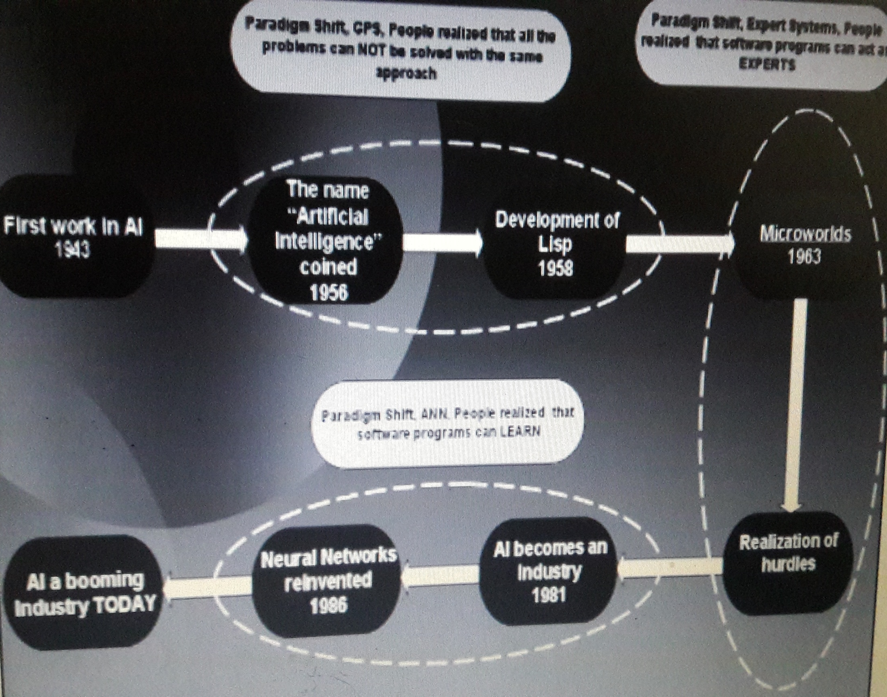

Slide 73
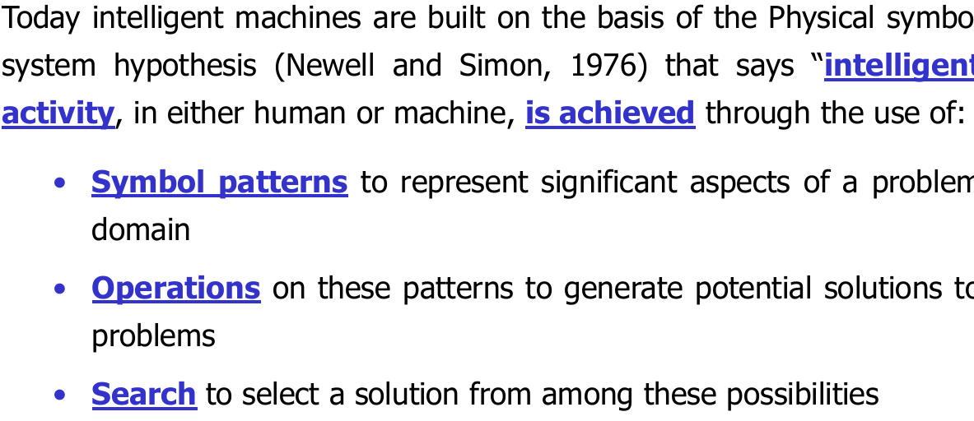
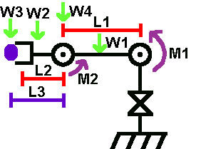

Slide 74
Computer vision
The world is composed of three-dimensional objects, but the inputs to the human eye and computers' TV cameras are two dimensional. Some useful programs can work solely in two dimensions, but full computer vision requires partial three-dimensional information that is not just a set of two-dimensional views. At present there are only limited ways of representing three-dimensional information directly, and they are not as good as what humans evidently use.

Slide 75
Some Common Application of AI
speech recognition
In the 1990s, computer speech recognition reached a practical level for limited purposes. Thus United Airlines has replaced its keyboard tree for flight information by a system using speech recognition of flight numbers and city names. It is quite convenient. On the the other hand, while it is possible to instruct some computers using speech, most users have gone back to the keyboard and the mouse as still more convenient.

Slide 76
Game playing
You can buy machines that can play master level chess for a few hundred dollars. There is some AI in them, but they play well against people mainly through brute force computation--looking at hundreds of thousands of positions. To beat a world champion by brute force and known reliable heuristics requires being able to look at 200 million positions per second.

Slide 77
AI in industries
In industries Artificial intelligence dependency is enormously increasing. It preform the following operations
In manufacturing
Packing operations
Casting and molding by Robotic arms
Keep supervision of the malfunctioning
IN short replacing middle worker

Slide 78
AI in Engineering
Artificial Intelligence (AI) techniques are now being used by the practicing engineer to solve a whole range of hitherto intractable problems.
Real-time intelligent automation, and their associated supporting methodologies and techniques, including control theory and industrial informatics,
Architectures, algorithms and techniques for distributed AI systems, including multi-agent based control and holonic control,
Decision-support systems,
Aspects of reasoning: abductive, case-based, model-based, non-monotonic, incomplete, progressive and approximate reasoning,
Applications of chaos theory and fractals,
Metaheuristics and their applications in intelligent automation: Genetic Algorithms,

Slide 79
AI in medical field
Reduced mortality rate
Artificial intelligence is what gives computers the ability to learn, think, reason, and even understand human emotions, allowing computers to do more then just repetive tasks. In the medical field, AI is being designed to assist doctors (not replace them) in the effort to reduce the mortality rate among patients awaiting care from specialists
Fast and accurate diagnostics
In the case of AI, the neural network of the brain is successfully imitated, even including the ability to learn from past cases. Several studies on artificial neural networks showed that they are able to accurately diagnose some diseases including malignant melanoma, eye problems, and many forms of cancer by analyzing spectral information and diagnostic criteria.

Slide 80

Reduce errors related to human fatigue
Doctors see roughly 80 patients per week, which can be very exhausting considering the individual amount of attention and knowledge each person requires. Unlike a human doctor, AI is un-phased by numbers of patients, long work hours, and task redundancy. Think of AI as sort of a super-human spell checker, assisting doctors by eliminating human error and relieving them of time consuming, monotonous tasks.

Slide 81
Mobile
A mobile phone is an electronic device that can make and receive calls over a radio frequency carrier while the user is moving within a telephone service area.
The radio frequency link establishes a connection to the switching systems of a mobile phone operator, which provides access to the public switched telephone network (PSTN). Most modern mobile telephone services use a cellular network architecture, and therefore mobile telephones are often also called cellular telephones or cell phones.
In addition to telephony, modern mobile phones support a variety of other services, such as text messaging, MMS, email, Internet access, short-range wireless communications (infrared, Bluetooth), business applications, gaming, and photography. Mobile phones which offer these and more general computing capabilities are referred to as smart phones.

Slide 82
The first handheld mobile phone was demonstrated by John F. Mitchell and Martin Cooper of Motorola in 1973, using a handset weighing c. 4.4 lbs (2 kg). In 1983, the DynaTAC 8000x was the first commercially available handheld mobile phone. From 1983 to 2014, worldwide mobile phone subscriptions grew to over seven billion, penetrating 100% of the global population and reaching the bottom of the economic pyramid. In 2014, the top mobile phone manufacturers were Samsung, Nokia, Apple, and LG

Slide 83
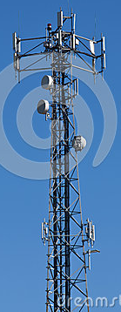
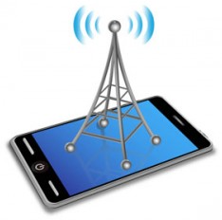
Working of mobile phones
When you make a call on your mobile phone, it emits electromagnetic radio waves also known as radio frequency, or RF energy.
Antenna from the nearest cell
phone tower will then receive
these radio waves.
After receiving signal from
a mobile phone,
the cell phone tower
then transmits the signals to a "switching center" –
a telephone exchange for mobile phones. Here the call is connected either to another mobile phone or to telephone network.

Slide 84
3G/4G modem can be installed on site to allow administrators to communicate with devices at a dead cell tower via the nearest functioning cell tower.
A cell phone offers full Duplex Communication and transfer the link when the user moves from one cell to another. As the phone user moves from one cell area to another, the system automatically commands the mobile phone and a cell site with a stronger signal, to switch on to a new frequency in order to keep the link.
Mobile phone is primarily designed for Voice communication. In addition to the standard voice function, new generation mobile phones support many additional services, and accessories, such as SMS for text messaging, email, packet switching for access to the Internet, gaming, Bluetooth, camera with video recorder and MMS for sending and receiving photos and video, MP3 player, radio and GPS.

Slide 85
FDMA and CDMA Systems
Frequency Division Multiple Access (FDMA) and Code Division Multiple Access (CDMA) were developed to distinguish signals from several different transmitters. In FDMA, the transmitting and receiving frequencies used in each cell are different from the frequencies used in the neighboring cells. The principle of CDMA is more complex and the distributed transceivers can select one cell and listen to it. Other methods include Polarization Division Multiple Access (PDMA) and Time Division Multiple Access (TDMA). Time division multiple access is used in combination with either FDMA or CDMA to give multiple channels within the coverage area of a single cell.

Slide 86
Mobile Network
Mobile phone converts voice, text, multi-media messages or data calls into Radio Frequencies (RF). Mobile phone base stations transmit and receive these RF signals and connect callers to other phones and other networks. Mobile phone network is divided into thousands of overlapping, individual geographic areas or ‘cells’, each with a base station. The size of a cell depends on the area of coverage and the number of calls that are made in that area. The smallest cells are in crowded urban areas with large buildings and heavy population density, while the biggest cells are in rural areas, where people are dispersed.
There are two types of channels used in GSM . These are Control channels and Traffic channels.

Slide 87
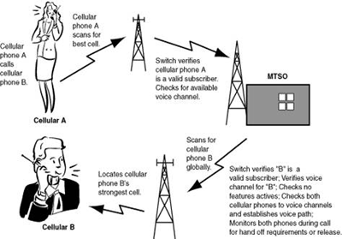
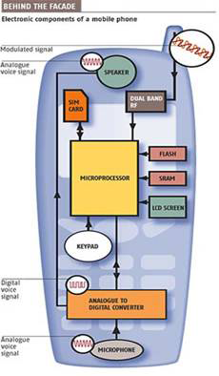

Slide 88
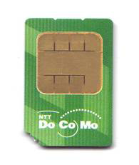
Subscriber Identification Module SIM
When the Mobile phone is used for the first time, it sends a number called International Mobile Subscriber Identity – IMSI present in the SIM card to the network, which looks it up in a database to ensure the card is registered. If the IMSI is recognized, the network creates another number called a Temporary Mobile Subscriber Identity (TMSI), which is encrypted and sent back to the phone. In all subsequent calls, the phone identifies itself by broadcasting the TMSI.
When we switch on the mobile phone, it tries for an SID on the Control channel. The Control channel is a special frequency that the phone and base station use to talk to one another. If the Mobile phone finds difficulty to get link with the control channel, it displays a “no service” message.

Slide 89
Satellites
A satellite is a moon, planet or machine that orbits a planet or star. For example, Earth is a satellite because it orbits the sun. Likewise, the moon is a satellite because it orbits Earth. Usually, the word "satellite" refers to a machine that is launched into space and moves around Earth or another body in space.
Earth and the moon are examples of natural satellites. Thousands of artificial, or man-made, satellites orbit Earth. Some take pictures of the planet that help meteorologists predict weather
The world's first artificial satellite, the Sputnik 1, was launched by the Soviet Union in 1957.

Slide 90
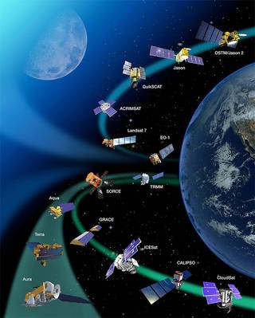
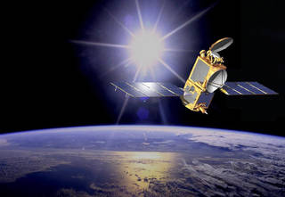
Still other satellites are used mainly for communications, such as beaming TV signals and phone calls around the world. A group of more than 20 satellites make up the Global Positioning System, or GPS. If you have a GPS receiver, these satellites can help figure out your exact location.
The Jason-2 satellite orbits Earth. It carries tools and sensors to help scientists study the oceans.
Credits: NASA

Slide 91
Satellites are used for a large number of purposes.
The bird's-eye view that satellites have allows them to see large areas of Earth at one time.
Military
civilian Earth observation satellites
communications satellites
navigation satellites
weather satellites
TV signals and phone calls are sent upward to a satellite. Then, almost instantly, the satellite can send them back down to different locations on Earth. Before satellites, TV signals didn't go very far

Slide 92
How satellite lunched into an orbit
Satellites are propelled by rockets to their orbits. Usually the launch vehicle itself is a rocket lifting off from a launch pad on land. Rocket consist of 80% sold fuel and 20% weight of the body.
It work on Newton 3rd law of motion and speed of gases is equal to 4000 meter second
Satellites are usually semi-independent computer-controlled systems. Satellite subsystems attend many tasks, such as power generation, thermal control,

Slide 93
What Are the Parts of a Satellite
Satellites come in many shapes and sizes. But most have at least two parts in common - an antenna and a power source. The antenna sends and receives information, often to and from Earth. The power source can be a solar panel or battery. Solar panels make power by turning sunlight into electricity.
Many NASA satellites carry cameras and scientific sensors. Sometimes these instruments point toward Earth to gather information about its land, air and water. Other times they face toward space to collect data from the solar system and universe.

Slide 94
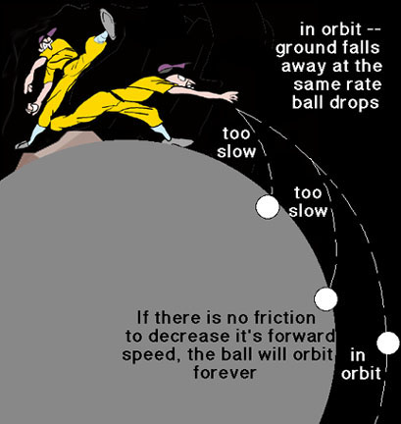
How Do Satellites Orbit Earth?
Most satellites are launched into space on rockets.. Without this balance, the satellite would fly in a straight line off into space or fall back to Earth. Satellites orbit Earth at different heights, different speeds and along different paths. The two most common types of orbit are "geostationary" (jee-oh-STAY-shun-air-ee) and "polar."
A geostationary satellite travels from west to east over the equator. It moves in the same direction and at the same rate Earth is spinning. From Earth, a geostationary satellite looks like it is standing still since it is always above the same location.
Polar-orbiting satellites travel in a north-south direction from pole to pole. As Earth spins underneath, these satellites can scan the entire globe, one strip at a time.

Slide 95
SONAR and RADAR
Sonar, short for Sound Navigation and Ranging, is helpful for exploring and mapping the ocean because sound waves travel farther in the water than do radar and light waves. NOAA scientists primarily use sonar to develop nautical charts, locate underwater hazards to navigation, search for and map objects on the sea floor such as shipwrecks, and map the sea floor itself. There are two types of sonar—active and passive.
Active Sonar
Active sonar transducers emit an acoustic signal or pulse of sound into the water. If an object is in the path of the sound pulse, the sound bounces off the object and returns an “echo” to the sonar transducer. If the transducer is equipped with the ability to receive signals, it measures the strength of the signal. By determining the time between the emission of the sound pulse and its reception, the transducer can determine the range and orientation of the object.
Passive Sonar
Passive sonar systems are used primarily to detect noise from marine objects (such as submarines or ships) and marine animals like whales. Unlike active sonar, passive sonar does not emit its own signal, which is an advantage for military vessels that do not want to be found or for scientific missions that concentrate on quietly “listening” to the ocean. Rather, it only detects sound waves coming towards it. Passive sonar cannot measure the range of an object unless it is used in conjunction with other passive listening devices. Multiple passive sonar devices may allow for triangulation of a sound source.

Slide 96
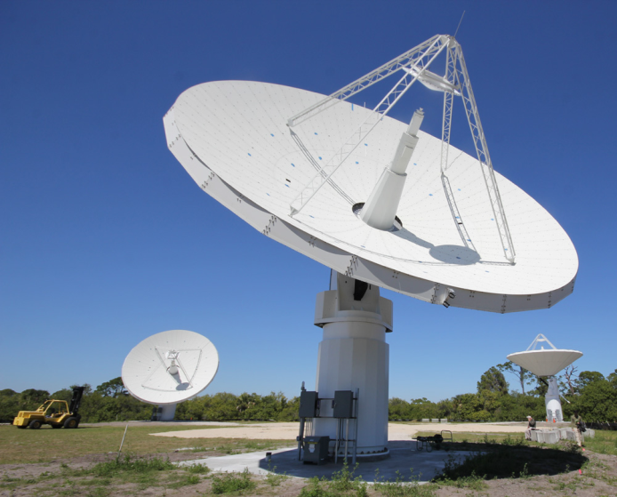
RADRA
Radar is an object-detection system that uses radio waves to determine the range, angle, or velocity of objects. It can be used to detect aircraft, ships, spacecraft, guided missiles, motor vehicles, weather formations, and terrain. A radar transmits radio waves or microwaves that reflect from any object in their path. A receive radar, which is typically the same system as the transmit radar, receives and processes these reflected waves to determine properties of the object(s).
A radar system has a transmitter that emits radio waves called radar signals in predetermined directions. When these come into contact with an object they are usually reflected or scattered in many directions. Radar signals are reflected especially well by materials of considerable electrical conductivity—especially by most metals, by seawater and by wet ground. Some of these make the use of radar altimeters possible. The radar signals that are reflected back towards the transmitter are the desirable ones that make radar work

Slide 97
. If the object is moving either toward or away from the transmitter, there is a slight equivalent change in the frequency of the radio waves, caused by the Doppler effect.
Radar receivers are usually, but not always, in the same location as the transmitter. Although the reflected radar signals captured by the receiving antenna are usually very weak,
they can be strengthened by electronic amplifiers. More sophisticated methods of signal processing are also used in order to recover useful radar signals.
The weak absorption of radio waves by the medium through which it passes is what enables radar sets to detect objects at relatively long ranges—ranges at which other electromagnetic wavelengths, such as visible light, infrared light, and ultraviolet light, are too strongly attenuated. Such weather phenomena as fog, clouds, rain, falling snow, and sleet that block visible light are usually transparent to radio waves. Certain radio frequencies that are absorbed or scattered by water vapor, raindrops, or atmospheric gases (especially oxygen) are avoided in designing radars, except when their detection is intended.

Slide 98
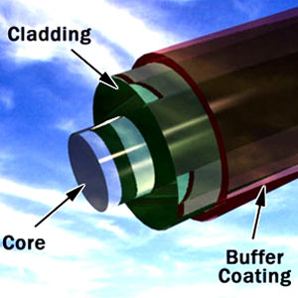
FIBER OPTICS
Fiber-optic lines are strands of optically pure glass as thin as a human hair that carry digital information over long distances.
The field of fiber optics depends upon the total internal reflection of light rays traveling through tiny optical fibers. The fibers are so small that once the light is introduced into the fiber with an angle within the confines of the numerical aperture of the fiber, it will continue to reflect almost losslessly off the walls of the fiber and thus can travel long distances in the fiber. Bundles of such fibers can accomplish imaging of otherwise inaccessible areas.

Slide 99
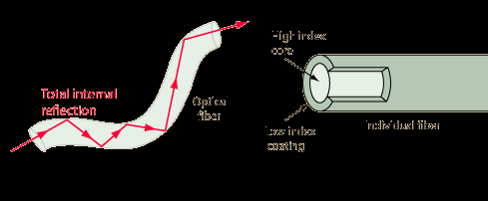
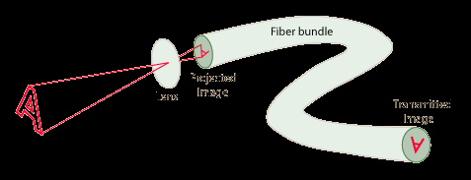
Fiber Optic Imaging
Fiber optic imaging uses the fact that the light striking the end of an individual fiber will be transmitted to the other end of that fiber. Each fiber acts as a light pipe, transmitting the light from that part of the image along the fiber. If the arrangement of the fibers in the bundle is kept constant then the transmitted light forms a mosaic image of the light which struck the end of the bundle.
Imaging used widely in medical diagnosis and in mechanical engineering inspections.

Slide 100
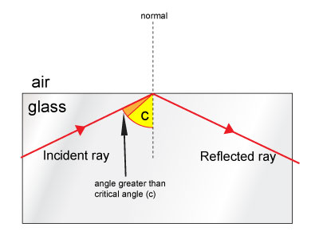
Why TOTAL INTERNAL Refraction in fiber optics

Slide 101
Applications of Fiber Optics
optical cabling is an excellent choice for the military's retrieval and deployment applications.
Missile launchers and radar systems have also begun to utilize these benefits. In many of their control systems, a single pencil-sized optical fiber can replace miles (and pounds) of copper wiring. In 2014, the U.S. Army plans to introduce an Abrams tank that will be almost two tons lighter than the current version, all due to replacing copper wiring with its lighter, faster, more secure counterpart
The extra bandwidth offered also enables cable television to transmit signals to their subscribers faster and more efficient.

Slide 102
Use in Medical Field
Endoscopic imaging
Fiber optic imaging uses the fact that the light striking the end of an individual fiber will be transmitted to the other end of that fiber. Each fiber acts as a light pipe, transmitting the light from that part of the image along the fiber. If the arrangement of the fibers in the bundle is kept constant then the transmitted light forms a mosaic image of the light which struck the end of the bundle.

Slide 103
Remote Sensing
“Remote sensing is the acquisition of information about an object or phenomenon without making physical contact with the object”
Remote sensing refers to the activities of recording/observing/perceiving (sensing) objects or events at far away (remote) places. In remote sensing, the sensors are not in direct contact with the objects or events being observed.
The information needs a physical carrier to travel from the objects/events to the sensors through an intervening medium. The electromagnetic radiation is normally used as an information carrier in remote sensing. The

Slide 104
The output of a remote sensing system is usually an image representing the scene being observed.
We perceive the surrounding world through our five senses. Some senses (touch and taste) require contact of our sensing organs with the objects. However, we acquire much information about our surrounding through the senses of sight and hearing which do not require close contact between the sensing organs and the external objects. In another word, we are performing Remote Sensing all the time.
In a more restricted sense, remote sensing usually refers to the technology of acquiring information about the earth's surface (land and ocean) and atmosphere using sensors onboard airborne (aircraft, balloons) or spaceborne (satellites, space shuttles) platforms.

Slide 105
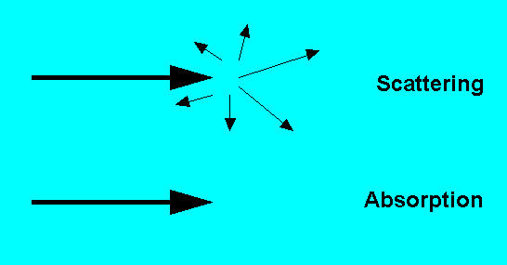
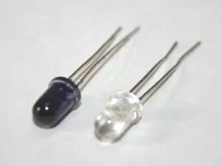
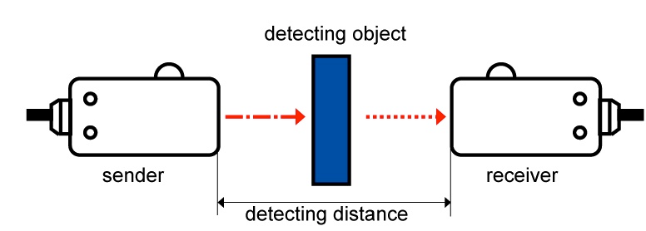
Cheap but low ranged
White transmitter and Black is receiver
Long range

Slide 106
Remote sensing using Transmitter and receiver
IR, infrared, is a range of colors that is not visible to humans, though some animals can see in that range. Its wavelength is just below red. An IR transmitter has an infrared light source which is simply turned on and off in a code kind of like Morse code that the corresponding IR receiver can understand.
The invisoble to human light needs to shine on subject to transmit data.
If your receiver is a photodiode it isn't really a switch - it absorbs light and produces a current, which is used in the circuit attached to the diode. Visible light has more energy than IR, so it will produce a photocurrent, too.

Slide 107
Satellite Remote Sensing
In this CD, you will see many remote sensing images around Asia acquired by earth observation satellites. These remote sensing satellites are equipped with sensors looking down to the earth. They are the "eyes in the sky" constantly observing the earth as they go round in predictable orbits.
Effects of Atmosphere
In satellite remote sensing of the earth, the sensors are looking through a layer of atmosphere separating the sensors from the Earth's surface being observed. Hence, it is essential to understand the effects of atmosphere on the electromagnetic radiation travelling from the Earth to the sensor through the atmosphere. The atmospheric constituents cause wavelength dependent absorption and scattering of radiation. These effects degrade the quality of images. Some of the atmospheric effects can be corrected before the images are subjected to further analysis and interpretation.
A consequence of atmospheric absorption is that certain wavelength bands in the electromagnetic spectrum are strongly absorbed and effectively blocked by the atmosphere. The wavelength regions in the electromagnetic spectrum usable for remote sensing are determined by their ability to penetrate atmosphere. These regions are known as the atmospheric transmission windows. Remote sensing systems are often designed to operate within one or more of the atmospheric windows. These windows exist in the microwave region, some wavelength bands in the infrared, the entire visible region and part of the near ultraviolet regions. Although the atmosphere is practically transparent to x-rays and gamma rays, these radiations are not normally used in remote sensing of the earth.

Slide 108
Environmental Applications of GPS Remote Sensing
The U. S. Environmental Protection Agency (EPA) conducts four types of satellite and aerial remote sensing projects to support the Comprehensive Environmental Response, Compensation, and Liability Act (CERCLA, also known as the Superfund Act), the Resource Conservation and Recovery Act (RCRA), and in other EPA regulatory programs and investigations. The projects are:

Slide 109
Emergency response to hazardous material release that requires rapid site assessment;
single-date analysis to update old data on the current conditions of the site;
intensive site analysis of current and historic images, to obtain an understanding of changing conditions over time; and
Waste site inventories over large areas to locate possible disposal sites.
Images from these projects can standalone or be used in conjunction with topographic maps, digital elevation data, and other features stored in GIS databases. Recently, interest has developed in using satellites to monitor and enforce multilateral environmental agreements (MEAs), such as the Kyoto Protocol. Remote sensing data may be used in the future to ensure compliance with MEA requirements by both direct enforcement and by more indirect means, such as deterring non-compliance through high levels of transparency.

Slide 110
Land Use Planning and Change
These applications include estimations of primary production, biomass, crop yields, and to chart, vegetation type, deforestation, desertification, forest boundaries, forest harvest, soil erosion, and bush or forest fires. Landsat 7’s EMT+ sensor is especially useful in studying land use change because its data has been archived since the first Landsat mission in 1972
Forestry
Forestry applications for passive remote sensors include tree species surveys, monitoring clearcut operations, planning and observing burn areas, and studying successional forest growth.

Slide 111
Agriculture
Active sensors, carried on the RADARSAT and ERS satellites, are capable of making course scale distinctions between cover types such as late successional forests, newly planted forests, clear cut forests, burn areas, agricultural areas, and deserts. Active sensors are valuable tools for monitoring crop regulation compliance, forest clearing, and for taking general inventories of world forest densities.
Water Resources and Fisheries
SeaWiFS is designed to monitor oceans and track water indicators such as turbidity, sediment load and transport, primary production by marine phytoplankton, algal blooms, chlorophyll content, dissolved oxygen, and pH. Other applications include managing coral reefs, monitoring pollution and oil spills, and characterizing and monitoring short-term and long-term fish habitat

Slide 112
Climate Activity
In the past decade, various ozone-monitoring sensors have been launched to study global climate cycles. These include the TOMS sensor and many of the sensors on Terra, Aqua, and future EOS satellites. AVHRR data from NOAA’s POES satellites is used in conjunction with RADARSAT to monitor the polar ice sheets and iceberg movements
Disaster Management and Emergency Response
Remote sensing technologies can provide the government with the ability to avoid much of the damage caused by unforeseen natural disasters. While weather satellites have monitored hurricanes and tornados since the 1960s, other satellite sensors, such as ETM+ and MODIS, have potential applications for disaster management and response. Scientists have used ETM+ data to monitor patterns in floods, droughts, beach erosion, and volcanic activity over time. MODIS and ASTER data can forecast severe weather with a great degree of reliability, potentially saving states millions of dollars in unnecessary evacuation and emergency response.

Slide 113
Thank You

